Slide 1
RCCCCCCCCCCCCCCCCCCCCCCCCCCCCCCCCCCCCCCCCCCCCCCCCCCCCCCCCCCCCCChjgeeofkEcCPORT STUDIO
Notes:
Copyright: Satyam Computer Services Ltd.
Welcome to the session on Report Studio

Slide 2
Topics
  What is Report Studio
  Why Report Studio
  How to create a Report
  Types of Reports
  Report Studio-User Interface
  Formatting a Report
  Working with Data
  Working with Existing Reports
  Save a Report
  Run a Report
Copyright: Satyam Computer Servicesintegration * intelligence * insight
Notes:
Copyright: Satyam Computer Services Ltd.
This slide describes the TOC for this Report Studio session. TOC is listed below
What is Report Studio?
Why Report Studio?
How to create a Report?
Types of Reports?
Report Studio – User Interface
Formatting a Report
Working with Data
Working with Existing Reports
Save a Report
Run a Report

Slide 3
Introduction
What is Report Studio !!!!
Report Studio is a Web product for creating reports that analyze corporate data according to specific information needs.
Why Report Studio !!!!
Use to build sophisticated, multiple-page, multiple-query reports against multiple databases
Copyright: Satyam Computer Servicesintegration * intelligence * insight
Notes:
Copyright: Satyam Computer Services Ltd.
Report Studio is an important part of Cognos8 suite of products, which can be used for generating professional quality reports against multiple databases.

Slide 4
How to create a Report
Specify the Package
Specify the package that will provide items for the report. The packages that you use to generate reports are based on models that are created in the modeling tool, Framework Manager
Choose a Report Template
select a predefined template that is formatted as a particular report type
Copyright: Satyam Computer Servicesintegration * intelligence * insight
Notes:
Copyright: Satyam Computer Services Ltd.
This slide provides a high-level view of the steps to be done to create a report in Report Studio
While invoking Report Studio, you will be prompted to choose a package. This package should have been modeled in Framework Manager and published to Cognos Connection.
Choose a template from the list of templates(templates are available for different report types like list report, chart report,crosstab report,etc).
Add query items listed on the left hand side “Insertable Objects” pane based on the data requirements for that particular report by dragging them into the report template on the right hand side “Work Area” pane.
Report Studio Interface components are explained in subsequent slides.

Slide 5
Add Data to a Report
Select the data items that you want to appear in the report from the Insertable Objects pane, on the source tab, drag each data item to the location where you want it to appear.
Copyright: Satyam Computer Servicesintegration * intelligence * insight
Notes:
Copyright: Satyam Computer Services Ltd.
This slide is a continuation of the previous slide.

Slide 6
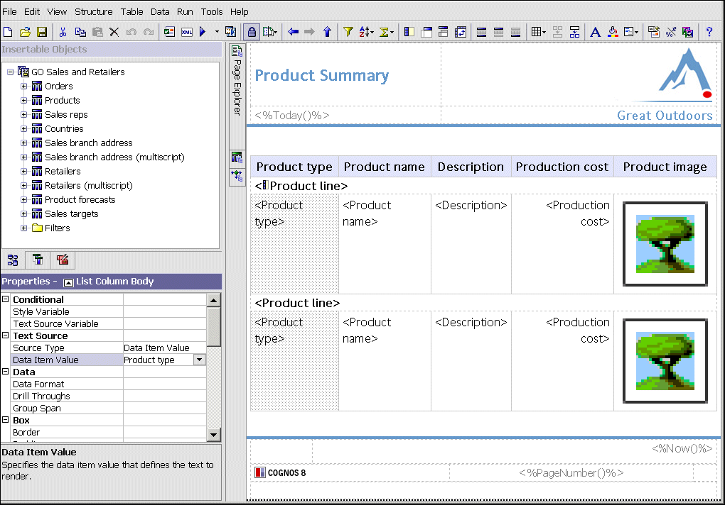
Report Studio-User Interface
Explorer bar
Insertable
Objects
pane
Properties
pane
Work area
Copyright: Satyam Computer Servicesintegration * intelligence * insight
Notes:
Copyright: Satyam Computer Services Ltd.
This slide shows the Report Studio Interface components
Insertable Objects Pane – This part of the interface lists the query subjects and query items contained in the package choses while invoking Report Studio
Work Area – This part of the interface contains the template which acts as a container for the query items dragged and dropped there (those items which form a part of the report)
Properties Pane – This part of the interface lists the properties of the item which is highlighted in the work area
Explorer Bar – This has 3 components
a) Page Explorer – This contains the report page and prompt page
b) Query Explorer – This contains the query items in the report page
c) Condition Explorer – This contains variables like Boolean variables, etc which are used in the report

Slide 7
Types of Reports
In Report Studio, you can create the following types of reports:
  List Report
  Crosstab Report
  Chart Report
  Map Report
  Repeater Report
Notes:
Copyright: Satyam Computer Services Ltd.
This slide list down the different types of reports which can be developed using Report Studio. They are
List Report
Crosstab Report
Chart Report
Map Report
Repeater Report
We will see each of these reports in subsequent slides

Slide 8
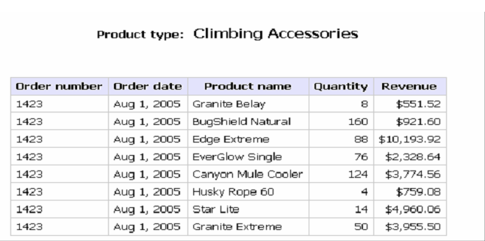
List Reports
Use list reports to show detailed information from your database, such as product lists and customer lists.
Copyright: Satyam Computer Servicesintegration * intelligence * insight
Notes:
Copyright: Satyam Computer Services Ltd.
This slide shows a list report. This report is used to show detailed information from your database, such as product list and customer list.
To create a list report
Choose the list report template while creating a new report
Drag and drop the required query items from the “Insertable Objects” pane
If you click the “Run Report” icon on the toolbar, the report will be executed and output will be shown on the screen.

Slide 9
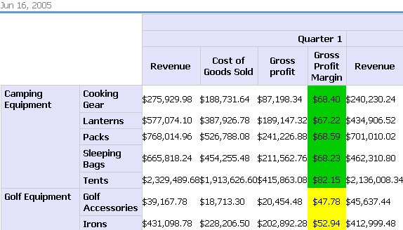
Crosstab Reports
Use crosstab reports to show information in a more compact form than in a grouped list.
Copyright: Satyam Computer Servicesintegration * intelligence * insight
Notes:
Copyright: Satyam Computer Services Ltd.
This slide shows a Crosstab report. Here, we have values for the measure at the intersection of each row and column. This report format is used to show information in a more compact form than in a grouped list. To create a report
1) Choose “Crosstab” template while creating a new report
2) Choose appropriate query items for rows and columns (they are non-measures)
3) Choose a measure for the top left hand corner of the cross tab.
4) If you click the “Run Report” icon on the toolbar, the report will be executed and the output will be shown on the screen.

Slide 10
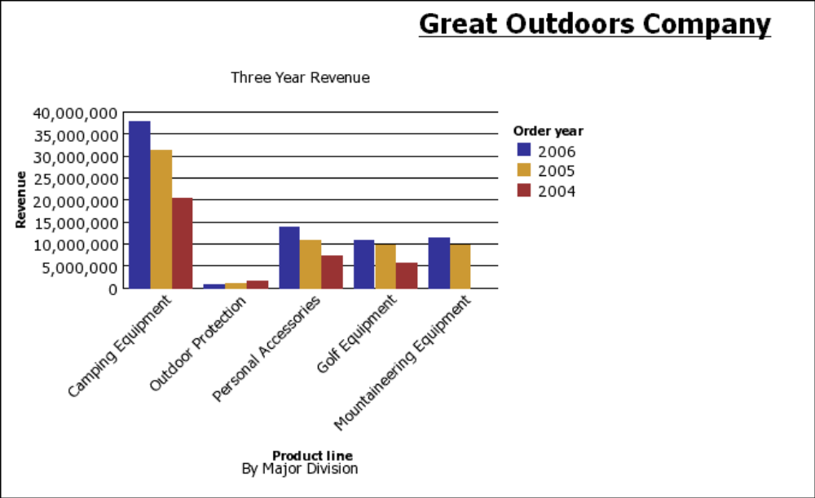
Charts
You can use Report Studio to create many chart types, including column, bar, area, and line charts.
Copyright: Satyam Computer Servicesintegration * intelligence * insight
Notes:
Copyright: Satyam Computer Services Ltd.
This slide shows a “Chart” report. We can create different types of charts like column, bar, line, etc. To create a column chart report
Choose “Chart” template while creating a new report and then choose “Column chart” for the chart type
Drag and drop the query items for x-axiz, y-axis and series.
If you now click “Run Report” icon, the report will be executed and output will be shown on the screen.

Slide 11
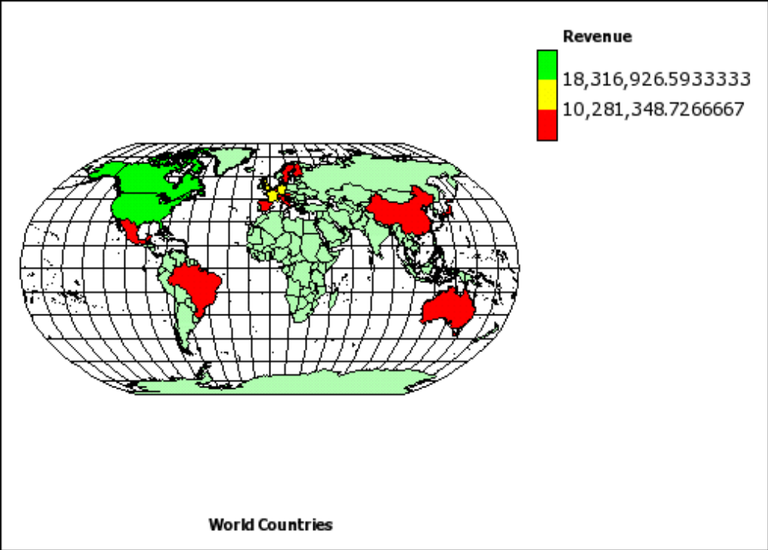
Maps
Report Studio provides a set of maps that you can use to represent tabular data in a spatial context.
Copyright: Satyam Computer Servicesintegration * intelligence * insight
Notes:
Copyright: Satyam Computer Services Ltd.
Report studio provides a set of maps that you can use to represent tabular data in a spatial context. For example, on a map of the world, countries can be colored to represent the level of revenue. Report studio maps provide the following three types of layers. They are
Region Layer – Specifies the regions on a map to be differentiated according to values in the data source.
Point Layer – Specifies the points to be placed on a map. The color and size of the points are based on the data that you select
Display Layer – You can show or hide items such as grid lines or capital cities. This layer is determined in the map file and not in the data source.
Steps
Select the map report and select Region countries + territories
Drag the revenue to the color and country to the location
Run the map report

Slide 12

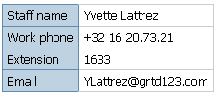
Repeaters
Use repeaters to repeat items when you run the report. For example, you can use repeaters to create mailing labels, including customer names and addresses.
Copyright: Satyam Computer Servicesintegration * intelligence * insight
Notes:
Copyright: Satyam Computer Services Ltd.
This slide shows about Repeater report. We can use repeaters to repeat items when we run the report. For example, we can use repeaters to create mailing labels. The following are the steps to create a repeater
Choose “Repeater Table” template while creating a new report
From the toolbox in the left hand side pane below “Insertable objects”, choose table and drag and drop it in the “Repeater Table”. You will be prompted for no. of rows and columns you want in the repeater. Choose appropriately.
Now, from the “Insertable Object” pane, drag and drop the required query items in one of the tables.
Now, if you click on “Run Report” icon, we can see the repeater with the data chosed repeating as many times as chosen by you.

Slide 13
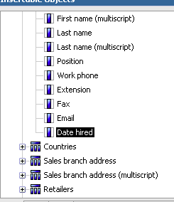
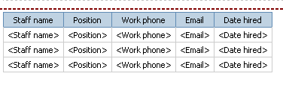
Example-Repeater
Convert List to Repeater
Prepare a list Report by dragging required columns
Copyright: Satyam Computer Servicesintegration * intelligence * insight
Notes:
Copyright: Satyam Computer Services Ltd.
This slide shows another way of creating a “Repeater” report by converting from a List Report to Repeater Report.
First step is , create a list report.

Slide 14
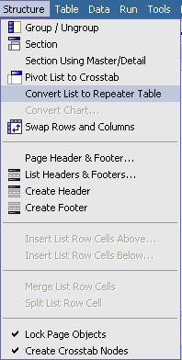

Example – Repeater
Select any column from the list and click Convert List
To Repeater Table option from Structure menu
Copyright: Satyam Computer Servicesintegration * intelligence * insight
Notes:
Copyright: Satyam Computer Services Ltd.
Step 2 is to select any column in the list and click on “Convert List to Repeater Table” option from “Structure” pull down menu.

Slide 15
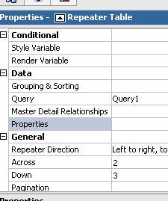
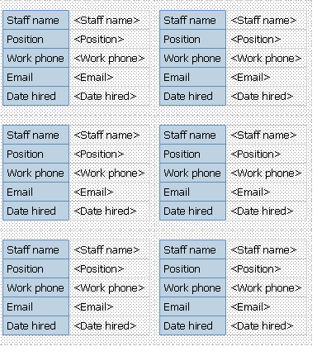
Example - Repeater
Change the Repeater table properties –Across, Down
Copyright: Satyam Computer Servicesintegration * intelligence * insight
Notes:
Copyright: Satyam Computer Services Ltd.
Step 3 is to specify “Across” and “Down” properties to have a value of your choice. You can easily navigate to this property sheet by choosing “Repeater Table” from “Select Ancestor” option at the top of the “properties” pane.

Slide 16
Formatting a Report
Format your report to make it more readable and to reflect company standards
  add a header or footer
  add borders
  add text
  specify the font
  add color
  insert an image
  add a bookmark
  insert other objects
  align an object
  use tables to control where objects appear
Copyright: Satyam Computer Servicesintegration * intelligence * insight
Notes:
Copyright: Satyam Computer Services Ltd.
This slide lists some of the formatting options that are available in Report Studio. These formatting can be done by highlighting the column to be formatted and choosing appropriate values for the corresponding properties in the properties pane on the left hand side.

Slide 17
Formatting a Report
  apply padding
  set margins
  reuse a layout object
  add a page
  reorder columns
  rename a column
  swap columns and rows
  set object properties
  create and modify classes
Copyright: Satyam Computer Servicesintegration * intelligence * insight
Notes:
Copyright: Satyam Computer Services Ltd.
This slide lists some more fomating options as a continuation of the previous slide

Slide 18
Working with Data
Make a report easier to read and easier to understand by specifying what data appears in the report and how the data looks
  Filter data
  Sort data
  Create sections
  Add a summary
  Create a calculation
Copyright: Satyam Computer Servicesintegration * intelligence * insight
Notes:
Copyright: Satyam Computer Services Ltd.
This slide lists the options available in Report Studio to make the report easier to read and understand by specifying what data appears on the report and how the data looks. Some of the options are
Filter data
Sort data
Create sections
Add a summary
Create a calculation

Slide 19
Working with Data
  Format data
  Specify the list of properties for a layout object
  Show data for a specific time period
  Define a prompt
  Work with queries
Copyright: Satyam Computer Servicesintegration * intelligence * insight
Notes:
Copyright: Satyam Computer Services Ltd.
This slide lists some more options as a continuation of the previous slide. Those options are
Format data
Specify the list of properties for a layout object
Show data for a specific time period
Define a prompt
Work with Queries

Slide 20
Filter Data
Add a filter expression to focus a report and minimize processing time by excluding unwanted data.
For example, you can filter data to show the products only Camping Equipments. When you run the report, you see only the filtered data.
Copyright: Satyam Computer Servicesintegration * intelligence * insight
Notes:
Copyright: Satyam Computer Services Ltd.
This slide shows filtering feature of Report Studio. Filtering is used in reports to focus it and to minimize processing time by excluding unwanted data. It also provides clarity to the report from an end user perspective since he/she need not see data not needed by him/her.
Steps to filter
Choose the column to be filtered on the work area
Click on “Filters” icon on the toolbar and build a filter expression in the wizard and click “ok”
Now, if you click “Run Report”, the report output will be displayed showing the filtered data.

Slide 21
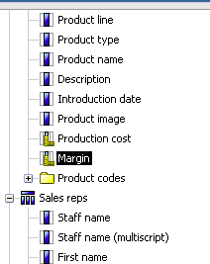
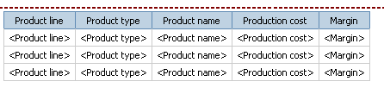
Example-Filters
Prepare a list Report by dragging required columns
Copyright: Satyam Computer Servicesintegration * intelligence * insight
Notes:
Copyright: Satyam Computer Services Ltd.
This slide shows how to user “filter” option on a list report
Step 1 is to prepare a new list report

Slide 22

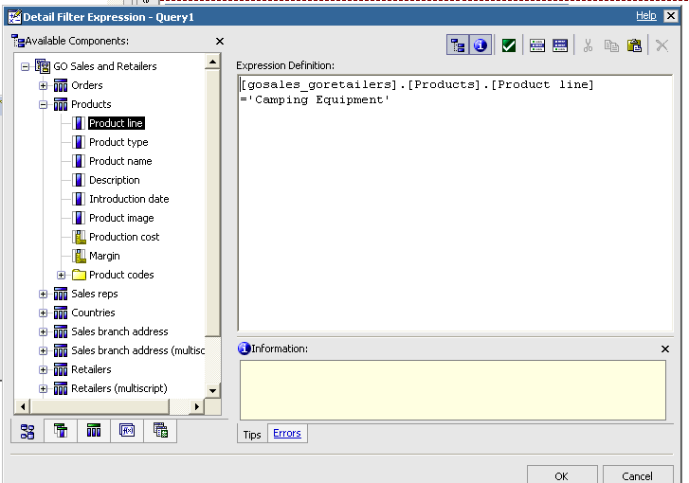
Example - Filters
Click filter button from tool bar
And add a filter condition in detail filter expression
Copyright: Satyam Computer Servicesintegration * intelligence * insight
Notes:
Copyright: Satyam Computer Services Ltd.
Step 2 is to click “Filter” icon in the toolbar and add a filter condition as shown in the slide

Slide 23
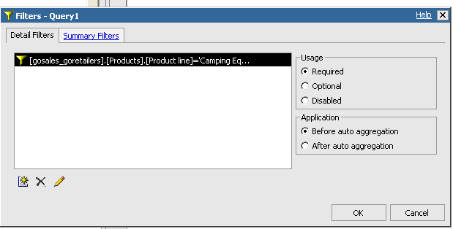
We can select the relavant radio buttons and clk OK
Copyright: Satyam Computer Servicesintegration * intelligence * insight
Notes:
Copyright: Satyam Computer Services Ltd.
Step 3 is to choose suitable radio buttons for “Usage” and “Application” as shown in the slide. Now, if you click “ok” and run the report, you will get report output with data filtered as per your specifications/filter condition

Slide 24
Sort Data
Organize data values in a report by specifying a sort order. Data can be organized in ascending or descending order based on the values in any data item.
Advanced Sorting:
You can perform advanced sorting in a list or crosstab. For example, in a list, you can sort columns within groups and change the sort order of columns.
Copyright: Satyam Computer Servicesintegration * intelligence * insight
Notes:
Copyright: Satyam Computer Services Ltd.
This slide shows sorting option in Report Studio
Highlight the column to be sorted.
Click on “Sort” icon. You can choose to sort “Ascending” or “Descending” as per your preference/requirement.
You can also choose “Advanced Sorting” which can be used ,for example, in a list, you can sort columns within groups and change the sort order of columns.
Now, if you run the report, the result will be sorted as per your specifications.

Slide 25
Adding Prompts
  You can add prompts to a report to add interactivity for users. Prompts act as questions that help users to customize the information in a report to suit their own needs.
  For example, you create a prompt so that users can select a product type. Only products belonging to the selected product type are retrieved and shown in the report.
Copyright: Satyam Computer Servicesintegration * intelligence * insight
Notes:
Copyright: Satyam Computer Services Ltd.
This slide shows about Prompt pages which can be used to dynamically filter data at runtime. For example, we can allow the users to select a product type in the prompt page. Now, if the user runs the report, the user will see data relevant to the option he/she chose in the prompt page.
Steps to build a prompt page
Highlight the column to be filtered.
Click on the “Build Prompt Page” icon in the toolbar. A prompt page template will be displayed.
From the toolbox below the “Insertable objects” pane, choose “Value prompt” and drag it to the prompt page. Fill out the options provided by the prompt page wizard.
Now, if the user runs the report, prompt page will appear and once the user selects one of the listed values, the report will be run and result will be shown only for the value chosen in the prompt page by the user.

Slide 26
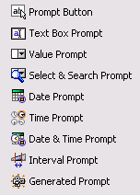
Examine Prompt Types
Choose the appropriate prompt type and style for your reporting requirements.
Copyright: Satyam Computer Servicesintegration * intelligence * insight
Notes:
Copyright: Satyam Computer Services Ltd.
This slide shows some of the prompt types available in Report Studio. This option is available from the toolbox below the “Insertable Objects” pane. Some of the options are
Tex Box prompt
Value prompt
Data prompt
Time prompt
Date & Time prompt, etc

Slide 27
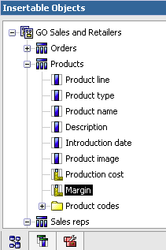
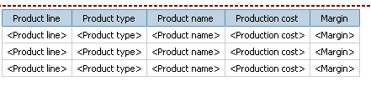
Example-Prompts
Prepare a list Report by dragging required columns from
Insertable objects pane
Copyright: Satyam Computer Servicesintegration * intelligence * insight
Notes:
Copyright: Satyam Computer Services Ltd.
This slide shows an example of how to use “prompts” in a list report
Step 1 is to prepare a new List report

Slide 28
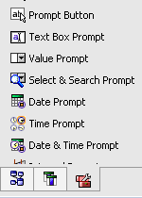
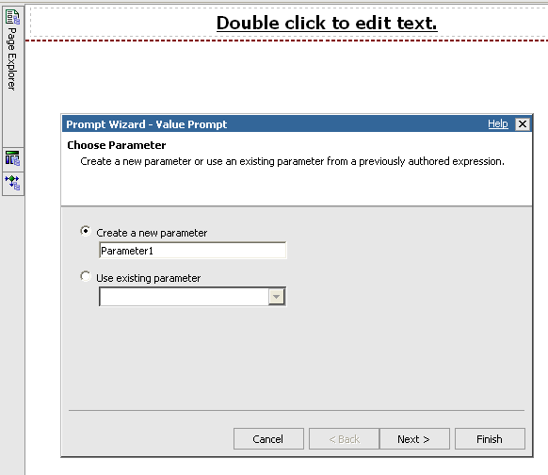
Example - Prompts
Click build prompt icon from tool bar
Drag a Value Prompt form tool box
Copyright: Satyam Computer Servicesintegration * intelligence * insight
Notes:
Copyright: Satyam Computer Services Ltd.
Step 2 is to click “Build prompt page” icon and then drag “Value prompt” to the prompt page. You will get a prompt wizard

Slide 29
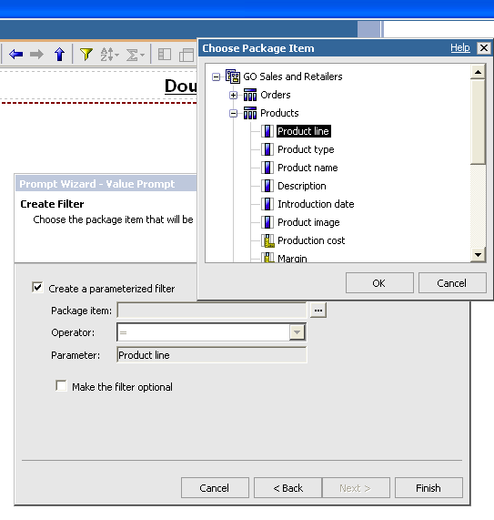
Example - Prompts
Select Package item
Copyright: Satyam Computer Servicesintegration * intelligence * insight
Notes:
Copyright: Satyam Computer Services Ltd.
Step 3 is to choose appropriate query item (which is to be filtered) in the prompt wizard.

Slide 30
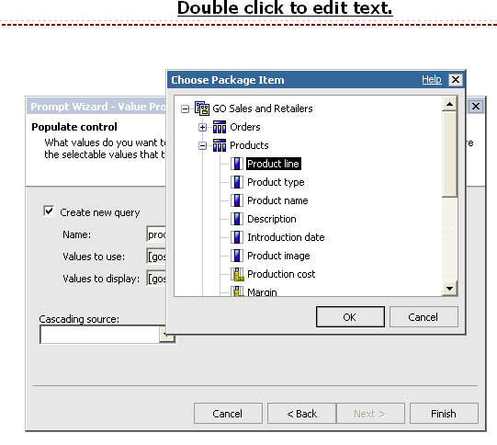
Example - Prompts
Select values to display
Copyright: Satyam Computer Servicesintegration * intelligence * insight
Notes:
Copyright: Satyam Computer Services Ltd.
Step 4 is to choose appropriate value for “Value to display” in the wizard. Generally, it will be same as “Value to Use”

Slide 31
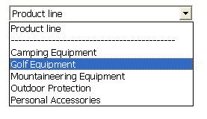

Example - Prompts
On running the report it will prompt the values
We select the values and click finish
Copyright: Satyam Computer Servicesintegration * intelligence * insight
Notes:
Copyright: Satyam Computer Services Ltd.
Step 5 is to run the report. While running, you will be prompted for a value for the query item to be filtered. Choose that and then click “Finish”. You will get a report according to the prompt value given by you.

Slide 32
Conditional Formatting
We can enhance a report by adding conditional formatting. For example, use conditional formatting to identify exceptional data in a report.
With conditional formatting, you can
  Hide and show objects
  Highlight data
  Add multiple layouts
  Create a multilingual report
Copyright: Satyam Computer Servicesintegration * intelligence * insight
Notes:
Copyright: Satyam Computer Services Ltd.
This slide talks about conditional formatting i.e. formatting of report output is changed based on conditions defined at design time and evaluated at run time. For example, you can use conditional formatting to identify exceptional data in a report. Some of the uses of conditional formatting are
Hide and show objects
Highlight data
Add multiple layouts
Create a multilingual report

Slide 33
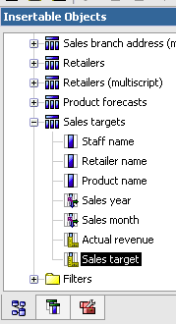

Example-Conditional Formatting
  Prepare a list Report by dragging required columns from
  Insertable objects
Copyright: Satyam Computer Servicesintegration * intelligence * insight
Notes:
Copyright: Satyam Computer Services Ltd.
This slide shows an example of conditional formatting for a list report.
Step 1 is to create a new list report as shown in the slide

Slide 34
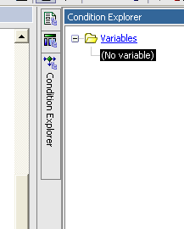
Example – Conditional Formatting
  In the explorer bar ,go to conditional explorer, click variables to create conditional variables
Copyright: Satyam Computer Servicesintegration * intelligence * insight
Notes:
Copyright: Satyam Computer Services Ltd.
Step 2 is to go to “Condition Explorer” and right click on “Variables” to create a contional variables

Slide 35
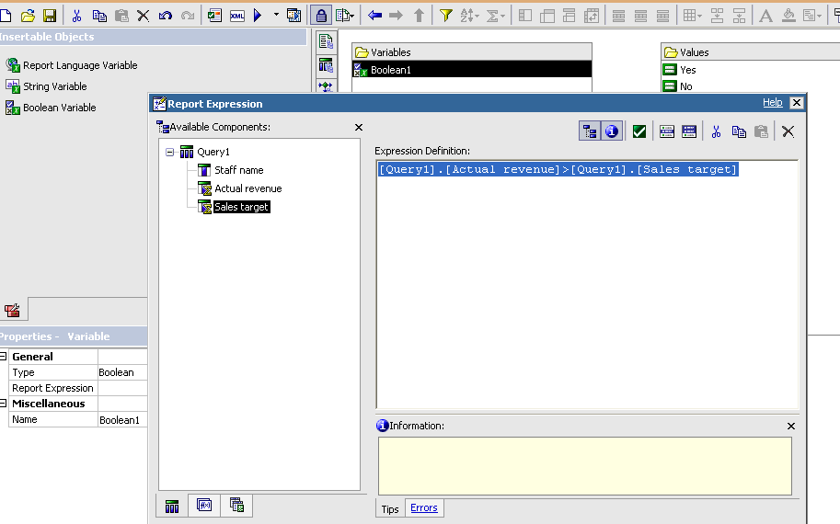
Example – Conditional Formatting
  Create a Boolean variable with a condition.
Copyright: Satyam Computer Servicesintegration * intelligence * insight
Notes:
Copyright: Satyam Computer Services Ltd.
Step 3 is to create a Boolean variable with a condition of your choice (say, sales target > 1000).

Slide 36
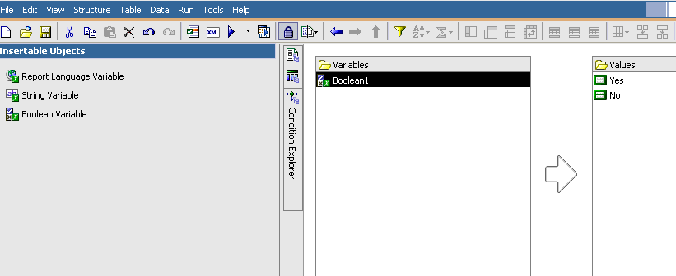
Example – Conditional Formatting
  Two values Yes, No will automatically be created
Copyright: Satyam Computer Servicesintegration * intelligence * insight
Notes:
Copyright: Satyam Computer Services Ltd.
When we create a Boolean variable, two values “Yes” and “No” will be created

Slide 37
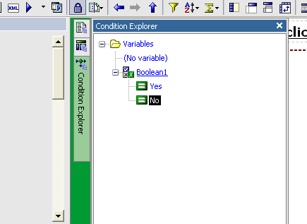
Example – Conditional Formatting
  Go to Report page, select the column and associate Boolean variable by clicking on that in explorer.
Copyright: Satyam Computer Servicesintegration * intelligence * insight
Notes:
Copyright: Satyam Computer Services Ltd.
Step 4 is to select the column (sales target) and associate the Boolean variable by clicking on that in “Condition explorer”

Slide 38
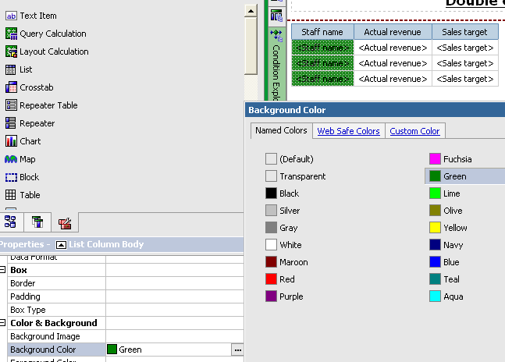
Example – Conditional Formatting
  For the values of boolean variables ,give conditional
  formatting for relavant columns in property box.
Copyright: Satyam Computer Servicesintegration * intelligence * insight
Notes:
Copyright: Satyam Computer Services Ltd.
Step 5 is to give conditional formatting (say font is red coloured if Boolean variable is true) for desired columns by using the properties in “Properties pane”

Slide 39
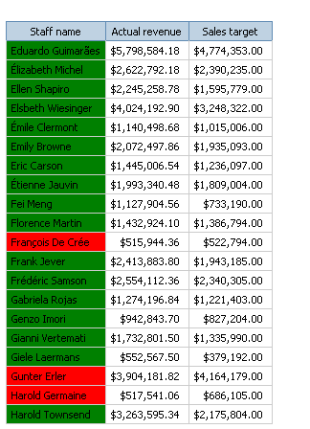
Example – Conditional Formatting
  This way we can highlight the exceptional data in the report through conditional formatting
Copyright: Satyam Computer Servicesintegration * intelligence * insight
Notes:
Copyright: Satyam Computer Services Ltd.
Step 6 is to run the report and you can get an output similar to the one shown in the slide, with data format changing as per the Boolean condition for that row.

Slide 40
Working with Existing Reports
After you have created a report, you can make changes or enhancements
  Open Reports from Other Studios
  Drill-through to another report
  Drill-up/drill-down in the same report
  Bursting Reports
  Create a master-detail relationship
Copyright: Satyam Computer Servicesintegration * intelligence * insight
Notes:
Copyright: Satyam Computer Services Ltd.
This slide lists some of the advanced futures of Report Studio
Open Reports from Other Studios – For example, Query Studio report can be opened in Report Studio and modified.
Drill-through to another report – For example, parent report lists the staff name and the sales revenue generated by the staff. We can design a child report which shows the details of the staff like designation, location,salary,etc. If drill-through is enable between these two reports, from the parent report, one can drill-through to child report for a particular staff of interest to know more about the staff.
Drill-up/Drill-down – This is the feature for travelling up or down the hierarchy of dimensional data.
Bursting Reports – We can generate a bulky report, separate sections of which is needed by different users. Then the relevant sections can be sent to concerned user by email automatically. This is called Bursting Report
Master –Detail Relationship – We can create a master report and detail report and link the two through a “master-detail” relationship available under “Data” option of the menu at the top. Here, for each value of master record, detail records are displayed.

Slide 41
Open Files from Other Studios
  You can open reports, templates, or analyses that were created in Query Studio or Analysis Studio in Report Studio
  All the capabilities of Report Studio are available to you, to change the formatting, layout, calculations, and queries
Copyright: Satyam Computer Servicesintegration * intelligence * insight
Notes:
Copyright: Satyam Computer Services Ltd.
This slide shows that query studio and analysis studio reports can be opened and modified in Report Studio. Only caution is once the report from other studios are edited and saved in report studio, they cannot be accessed from Query or analysis studios.

Slide 42
Drill-through Report
A drill-through report to link two reports containing related information. You can then access related or more detailed information in one report by selecting a value in another report.
Copyright: Satyam Computer Servicesintegration * intelligence * insight
Notes:
Copyright: Satyam Computer Services Ltd.
This slide describes the drill-through report. It is already explained in Slide number 40

Slide 43
Create a Drill-through Report
Create a drill-though report by adding a parameter to a child report and a drill-though connection from the parent report to the child report.
Open the child report
Add a parameter
Open the parent report
Create a drill-through connection to the child report
Copyright: Satyam Computer Servicesintegration * intelligence * insight
Notes:
Copyright: Satyam Computer Services Ltd.
This slide lists the steps to be done to create a drill-through to child report. The steps are
Create a child report.
Add a parameter to child report
Create a parent report with atleast one column common between parent and child report
Create a drill-through connection to child report using “Drill Throughs” icon on the tool bar
Now, if we run the parent report, the common column is hyperlinked and if you click that, child report will be displayed for that particular value of the common column.

Slide 44
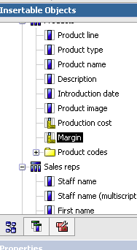
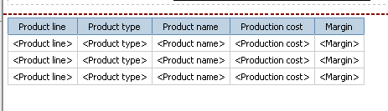
Example-Drill through
  Create a child report: By dragging required query items
Copyright: Satyam Computer Servicesintegration * intelligence * insight
Notes:
Copyright: Satyam Computer Services Ltd.
This slide shows an example of how to create a drill through report.
Step 1 is to create a new list report as shown in the slide

Slide 45
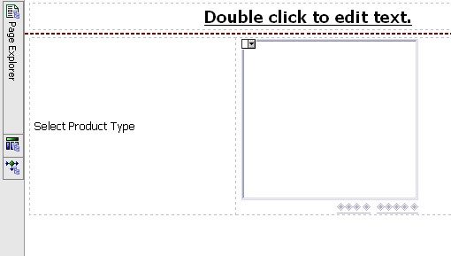
Example – Drill Through
  Add a prompt: Create a prompt that would take product
  type as input
Copyright: Satyam Computer Servicesintegration * intelligence * insight
Notes:
Copyright: Satyam Computer Services Ltd.
Step 2 is to create a prompt which will take “product type” as input value.

Slide 46
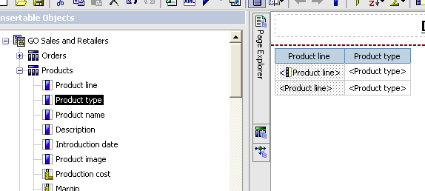
Example – Drill Through
  Create a parent report: From this report we do drill through
  to the child report
Copyright: Satyam Computer Servicesintegration * intelligence * insight
Notes:
Copyright: Satyam Computer Services Ltd.
Step 3 is to create a parent list report.

Slide 47

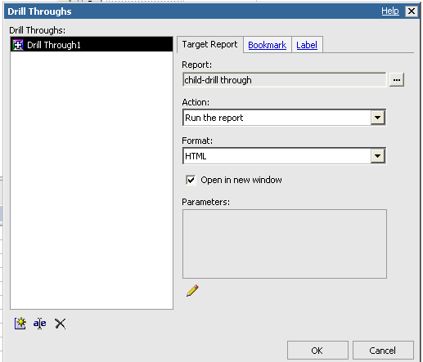
Example – Drill Through
  Create Drill through:
  Select the data Item, click Drill through icon on tool bar
Add a drill through
by providing necessary
Information
Copyright: Satyam Computer Servicesintegration * intelligence * insight
Notes:
Copyright: Satyam Computer Services Ltd.
Step 4 is to create a drill through by clicking the “Drill Through” icon in the toolbar and providing the required information in the pop up screen.

Slide 48
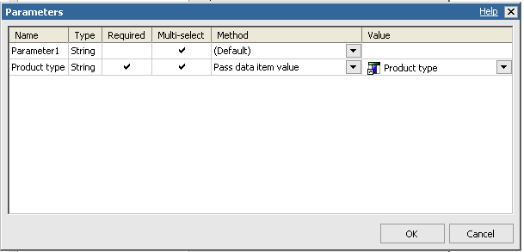
Example – Drill Through
  Add a parameter by selecting method as data item value, value as product Type.
Copyright: Satyam Computer Servicesintegration * intelligence * insight
Notes:
Copyright: Satyam Computer Services Ltd.
As part of step 4 (previous slide), you need to add a parameter in the pop up screen dialogue by selecting “Pass data item value” for “Method” and for “Value” provide “Product type” as input

Slide 49
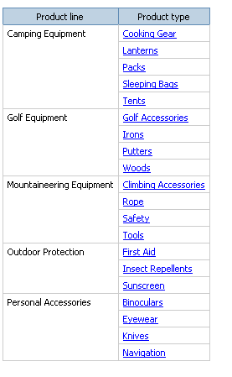
Example – Drill Through
  On running Drill through report it will appear as
Copyright: Satyam Computer Servicesintegration * intelligence * insight
Notes:
Copyright: Satyam Computer Services Ltd.
Step 5 is to run the report. Values in “Product Type” column will have hyperlink. When you click one of the hyperlink, child report output will be displayed for the chosed “Product type”

Slide 50
Bursting Reports
Bursting is the process of running a report once and then dividing the results for distribution to recipients who each view only a subset of the data.
  To create a burst report, you
  Define the burst recipients
  Specify burst groups
  Set burst options
  Enable bursting
Copyright: Satyam Computer Servicesintegration * intelligence * insight
Notes:
Copyright: Satyam Computer Services Ltd.
This slide explains an advanced feature of Report Studio called “Bursting Report”. Bursting is the process of running a report once and then dividing the results for distribution to receipients who view only a subset of the data. To create a burst report, you need to do the following
Define the burst receipients
Specify burst groups
Set burst options
Enable bursting

Slide 51
Master-Detail Report
  Create a master-detail relationship to deliver information that would otherwise require two or more reports
  you can combine a list with a chart. The list can contain product lines and the chart can show details for each product line.
Copyright: Satyam Computer Servicesintegration * intelligence * insight
Notes:
Copyright: Satyam Computer Services Ltd.
This slide explains a Master-Detail Report. We can use this to deliver information that would otherwise require two or more reports
Example : Master section can contain “Product lines” and the detail section can display the details for each product line.

Slide 52
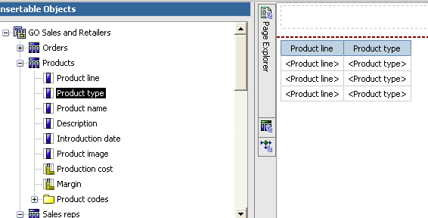
Example: Mater-Detail
  Create a Master List Report by dragging required objects
Copyright: Satyam Computer Servicesintegration * intelligence * insight
Notes:
Copyright: Satyam Computer Services Ltd.
This slide shows how to develop a Master-Detail Report
Step 1 is to create a Master List Report by draging & dropping required objects into the List Report template

Slide 53
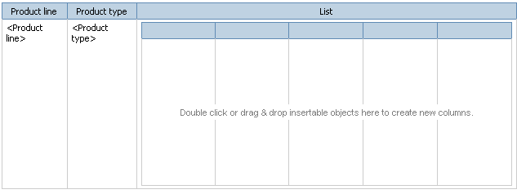
  Drag list object within the master list from tool box
Copyright: Satyam Computer Servicesintegration * intelligence * insight
Notes:
Copyright: Satyam Computer Services Ltd.
Step 2 is to drag “List Object” from toolbox to within the master list as shown in the slide

Slide 54
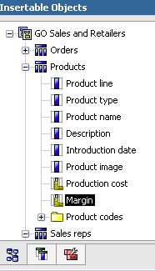
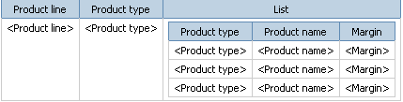
  Drag required objects on to the Detailed list from insertable
  Objects
Copyright: Satyam Computer Servicesintegration * intelligence * insight
Notes:
Copyright: Satyam Computer Services Ltd.
Step 3 is to drag required query items into the Detailed List template from “Insertable Objects” pane

Slide 55
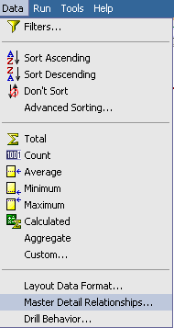
  Go to Data menu and clk Master Detail Relationships
Copyright: Satyam Computer Servicesintegration * intelligence * insight
Notes:
Copyright: Satyam Computer Services Ltd.
Step 4 is to invoke “Master Detail Relationships” menu item from Data menu.

Slide 56
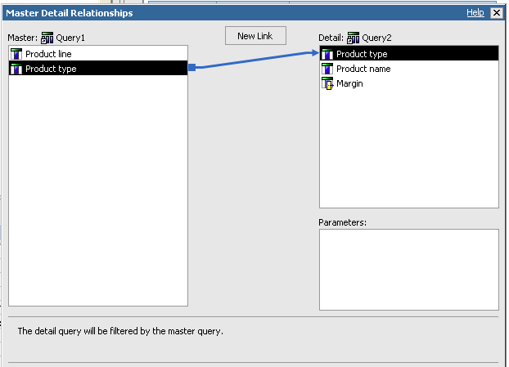
  Establish connection to common column
Copyright: Satyam Computer Servicesintegration * intelligence * insight
Notes:
Copyright: Satyam Computer Services Ltd.
Step 5 is to establish connection to the common column (column that links master and detail sections of the report)

Slide 57
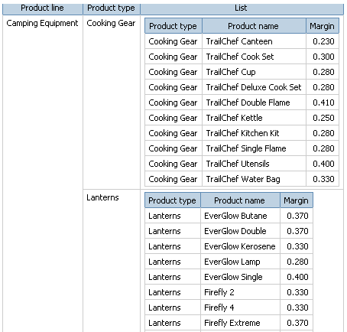
  Upon running the Report the out put looks like
Copyright: Satyam Computer Servicesintegration * intelligence * insight
Notes:
Copyright: Satyam Computer Services Ltd.
Step 6 is to run the report and you will see an output similar to that shown in the slide

Slide 58
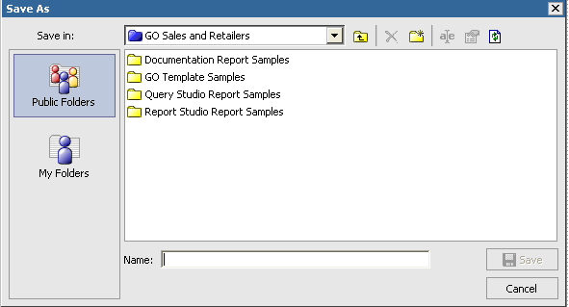
Save a Report
We can save our report on the Cognos 8 server in two different folders
Copyright: Satyam Computer Servicesintegration * intelligence * insight
Notes:
Copyright: Satyam Computer Services Ltd.
This slide shows that reports developed in Report Studio can be saved in either “Public Folder” or “My Folder”

Slide 59
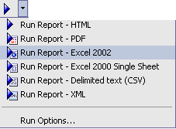
Run a Report
Run your report to see the data that is retrieved.
We can run a report in different formats
Copyright: Satyam Computer Servicesintegration * intelligence * insight
Notes:
Copyright: Satyam Computer Services Ltd.
This slide shows the various formats in which the report output can be obtained. They are
HTML
PDF
Excel 2002
Excel 2000 Single Sheet
Delimited text (CSV)
XML

Slide 60
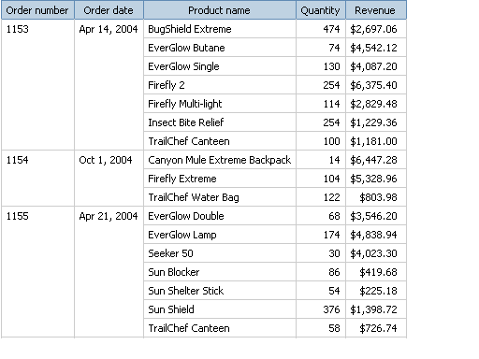
Example – Remove Identical Values in a list
  You can remove identical values from a list report as shown below
Copyright: Satyam Computer Servicesintegration * intelligence * insight
Notes:
Copyright: Satyam Computer Services Ltd.
This slide shows an example of a report where identical values are removed. Here, “Order Date” is displayed only when “Order Number” changes thereby improving the readability of the report.

Slide 61
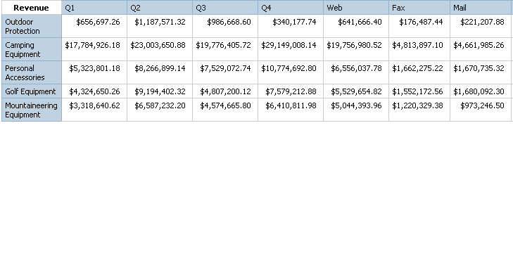
Example – Discontinuous Crosstab Report
You can create a discontinuous Crosstab Report as shown below
Copyright: Satyam Computer Servicesintegration * intelligence * insight
Notes:
Copyright: Satyam Computer Services Ltd.
Discontinuous Crosstab Report will have columns with data from different dimensions (here in the slide, by quarter and by order method). Discontinuous Crosstabs are also known as disconnected or disjoint crosstabs or crosstabs with unrelated columns

Slide 62
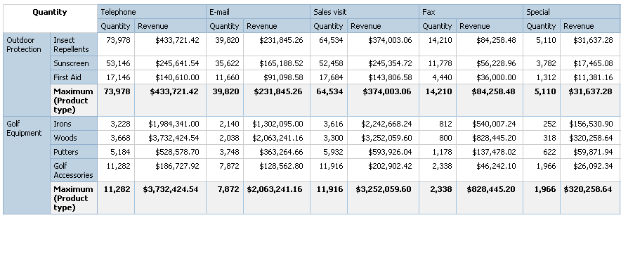
Example – Add aggregate data to a Crosstab Report
You can add aggregate data to a Crosstab report as shown below
Copyright: Satyam Computer Servicesintegration * intelligence * insight
Notes:
Copyright: Satyam Computer Services Ltd.
In the slide, a report is shown for showing sales by order method to determine which methods are generating the most revenue and the highest sales volume.

Slide 63
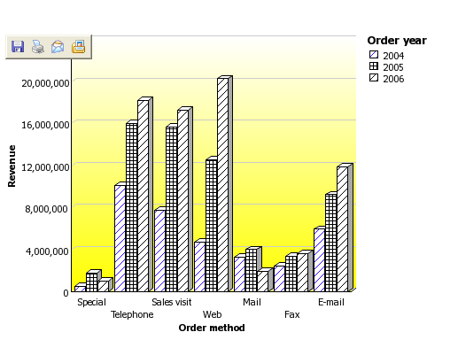
Example – Change the background of a Chart Report
You can change the background of a chart report as shown below
Copyright: Satyam Computer Servicesintegration * intelligence * insight
Notes:
Copyright: Satyam Computer Services Ltd.
This slide shows how to change the background color of a chart report. Yellow color gradient has been used as the background color in the slide.

Slide 64

Example – Add a baseline to a Chart Report
You can add a baseline to a Chart Report as shown below
Copyright: Satyam Computer Servicesintegration * intelligence * insight
Notes:
Copyright: Satyam Computer Services Ltd.
In this slide, a baseline (red, dotted line) is added as a baseline to indicate the mean revenue for the Chart Report.

Slide 65

Example – Add a Note to a Chart Report
You can add a note to a chart report as shown below
Copyright: Satyam Computer Servicesintegration * intelligence * insight
Notes:
Copyright: Satyam Computer Services Ltd.
In the slide, a Note (“Fax orders increased ….”) has been added to a chart report

Slide 66

Example – Customize the Axis Titles of a Chart Report
You can customize the Axis titles of a chart report as shown below
Copyright: Satyam Computer Servicesintegration * intelligence * insight
Notes:
Copyright: Satyam Computer Services Ltd.
Charts contain several titles, such as axis titles, report titles,etc. By default, axis titles are managed for you. To customize an axis title, you drag text items or data items to the axis title area in the chart. You can use a combination of text, data items and report expressions in titles. In the slide, axis title shows the “total revenue” for Product Line.

Slide 67

Example – Report showing Products Returned for a Specific Time Interval
You can create a report that shows products returned for a time interval
specified by the user as shown below
Copyright: Satyam Computer Servicesintegration * intelligence * insight
Notes:
Copyright: Satyam Computer Services Ltd.
Assume that you are working as a developer for a company which sells sporting equipments. You are requested to create a report that shows products returned for a time interval specified by the user. Interval prompt retrieves data based on a time interval that you specify. In the example shown in the slide, time interval chose is 30 days. The report shows the data where products were returned more than 30 days after the order date.

Slide 68

Example – Two-column List report for three data items
You can create a two-column List report for three data items as shown
below
Copyright: Satyam Computer Servicesintegration * intelligence * insight
Notes:
Copyright: Satyam Computer Services Ltd.
Assume that you are a report developer for a company that sells sporting equipments. You are requested to create a list report that shows revenues for all product lines and order methods. However, you want the product lines and order methods to appear in a single column. To create this report, you use a union query to join the Product line and Order method data items.

Slide 69

Example – Crosstab Report that shows Empty Rows
You can create a Crosstab Report that shows Empty Rows as shown
below
Copyright: Satyam Computer Servicesintegration * intelligence * insight
Notes:
Copyright: Satyam Computer Services Ltd.
Assume that you are a report developer for a company that sells sporting equipments. You are requested to create a crosstab report that shows the total revenue per year for each product line, broken down by order method. By default, if no revenue was produced for a particular product line in a specific year, no rows appear in the crosstab for that product line and year. You override the dimension information of the crosstab so that empty rows appear in the report.

Slide 70
References
Report Studio User Guide which is downloaded from the following site
Http://support.cognos.com
Copyright: Satyam Computer Servicesintegration * intelligence * insight

Slide 71
THANK YOU
Copyright: Satyam Computer Servicesintegration * intelligence * insight
Notes:
Copyright: Satyam Computer Services Ltd.
Thank you for your patience

